Slide 1
Concurrency Control
Chp 15, Database Systems, Korth , 6th edition

Slide 2
Lock Based Protocols
CONCURRENCY CONTROL
There are various modes in which a data item may be locked.
Shared. If a transaction Ti has obtained a shared-mode lock (denoted by S) on item Q, then Ti can read, but cannot write, Q.
Exclusive. If a transaction Ti has obtained an exclusive-mode lock (denoted by X) on item Q, then Ti can both read and write Q.
The transaction makes the request to the concurrency-control manager, which grants the lock to the transaction.
The use of these two lock modes allows multiple transactions to read a data item but limits write access to just one transaction at a time.
Sudha Bhagavatheeswaran, Department of Information Technology,
SIES College of Arts, Science & Commerce (Autonomous)

Slide 3
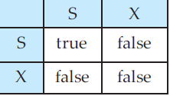
Lock Based Protocols
CONCURRENCY CONTROL
Let A and B represent arbitrary lock modes. Suppose that a transaction Ti requests a lock of mode A on item Q on which transaction Tj (Ti = Tj ) currently holds a lock of mode B.
If transaction Ti can be granted a lock on Q immediately, in spite of the presence of the mode B lock, then we say mode A is compatible with mode B.
A transaction requests a shared lock on data item Q by executing the lock-S(Q) instruction. A transaction can unlock a data item Q by the unlock(Q)instruction.
compatibility matrix
Sudha Bhagavatheeswaran, Department of Information Technology,
SIES College of Arts, Science & Commerce (Autonomous)

Slide 4
Lock Based Protocols
CONCURRENCY CONTROL
Ti is made to wait until all incompatible locks held by other transactions have been released
T1: lock-X(B);
read(B);
B := B − 50;
write(B);
unlock(B);
lock-X(A);
read(A);
A := A + 50;
write(A);
unlock(A).
TRANSACTION T1
lock-S(A);
read(A);
unlock(A);
lock-S(B);
read(B);
unlock(B);
display(A + B).
TRANSACTION T2
Sudha Bhagavatheeswaran, Department of Information Technology,
SIES College of Arts, Science & Commerce (Autonomous)

Slide 5
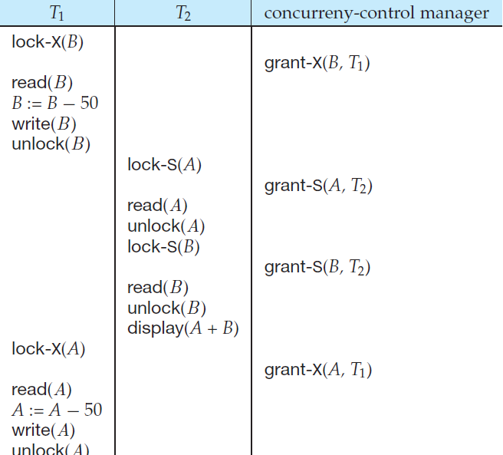
CONCURRENCY CONTROL
Sudha Bhagavatheeswaran, Department of Information Technology,
SIES College of Arts, Science & Commerce (Autonomous)

Slide 6
Granting of Locks
CONCURRENCY CONTROL
When a transaction requests a lock on a data item in a particular mode, and no other transaction has a lock on the same data item in a conflicting mode, the lock can be granted.
T2 – S(Q), T1 requests for X(Q), T1 must wait.
T3 requests for S(Q), it is granted since it is compatible.
T4 requests for S(Q), it is granted since it is compatible.
T1 will get X(Q) only after all release their S(Q). (starvation).
When a transaction Ti requests a lock on a data item Q in a particular mode M, the concurrency-control manager grants the lock provided that:
1. There is no other transaction holding a lock on Q in a mode that conflicts with M.
2. There is no other transaction that is waiting for a lock on Q and that made its lock request before Ti .
Sudha Bhagavatheeswaran, Department of Information Technology,
SIES College of Arts, Science & Commerce (Autonomous)

Slide 7
T1 | T2 | Concurrency control manager
lock-X(B)
 |  | grant - X(B,T1)
read(B)
B:=B-50
write(B)
 | lock-S(A)
 |  | grant - S(A,T2)
 | read(A)
 | lock-S(B)
 |  | not granted
lock-X(A)
 |  | not granted
DEADLOCK
ROLLBACK unlock(B)
 |  | grant - S(B,T2)
 | read(B)
 | display(A+B)
 | unlock(A)
lock-X(A)
 |  | grant - X(A,T1)
read(A)
A:=A-50
write(A)
unlock(A)
 | unlock(B)

Slide 8
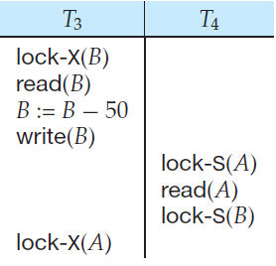
Deadlock
CONCURRENCY CONTROL
If we do not use locking, or if we unlock
data items too soon after reading or writing
them, we may get inconsistent states.
On the other hand, if we do not
unlock a data item before requesting a lock on another data item, deadlocks may occur.
When deadlock occurs, the system must roll back one of the two transactions.
Once a transaction has been rolled back, the data items that were locked by that transaction are unlocked.
Locking protocol, indicating when a transaction may lock and unlock each of the data items is a solution.
Sudha Bhagavatheeswaran, Department of Information Technology,
SIES College of Arts, Science & Commerce (Autonomous)

Slide 9
Two-Phase Locking Protocol
CONCURRENCY CONTROL
ensures serializability; does not avoid deadlock
Each transaction issue lock and unlock requests in two phases:
Growing phase. A transaction may obtain locks, but may not release any lock.
Shrinking phase. A transaction may release locks, but may not obtain any new locks.
Initially, a transaction is in the growing phase. The transaction acquires locks as needed.
Once the transaction releases a lock, it enters the shrinking phase, and it can issue no more lock requests.
Sudha Bhagavatheeswaran, Department of Information Technology,
SIES College of Arts, Science & Commerce (Autonomous)

Slide 10
Two-Phase Locking Protocol
CONCURRENCY CONTROL
The point in the schedule where the transaction has
obtained its final lock (the end of its growing phase) is called the lock point of the transaction.
transactions can now be ordered according to their lock points— this ordering is a serializability ordering for the transactions.
Sudha Bhagavatheeswaran, Department of Information Technology,
SIES College of Arts, Science & Commerce (Autonomous)

Slide 11
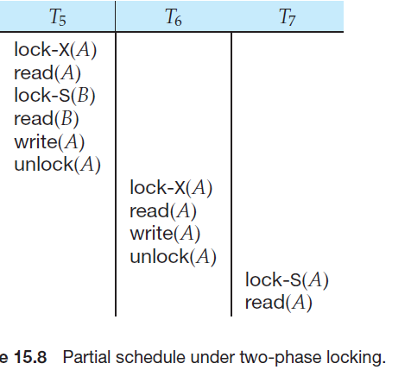
Two-Phase Locking Protocol
CONCURRENCY CONTROL
In addition to being serializable,
schedules should be cascadeless.
Cascading rollback may occur
under two-phase locking.
Each transaction observes the
two-phase locking protocol, but
the failure of T5 after the read(A)
step of T7 leads to cascading rollback of T6 and T7.
Sudha Bhagavatheeswaran, Department of Information Technology,
SIES College of Arts, Science & Commerce (Autonomous)

Slide 12
Two-Phase Locking Protocol
CONCURRENCY CONTROL
Cascading rollbacks can be avoided by a modification of two-phase locking called the strict two-phase locking protocol.
Strict two-phase lock - all exclusive-mode locks taken by a transaction be held until that transaction commits. This requirement ensures that any data written by an uncommitted transaction are locked in exclusive mode until the transaction commits, preventing any other transaction from reading the data. It avoids cascading rollbacks, but may deadlock
Another variant of two-phase locking is the rigorous two-phase locking protocol, which requires that all locks be held until the transaction commits. It avoids cascading rollbacks, but may deadlock.
Sudha Bhagavatheeswaran, Department of Information Technology,
SIES College of Arts, Science & Commerce (Autonomous)

Slide 13
Two-Phase Locking Protocol
CONCURRENCY CONTROL
lock conversions:- upgrading a shared lock to an exclusive lock, and downgrading an exclusive lock to a shared lock.
shared to exclusive modes - upgrade, and from exclusive to shared – downgrade
upgrading can take place in only the growing phase,
whereas downgrading can take place in only the shrinking phase.
Sudha Bhagavatheeswaran, Department of Information Technology,
SIES College of Arts, Science & Commerce (Autonomous)

Slide 14
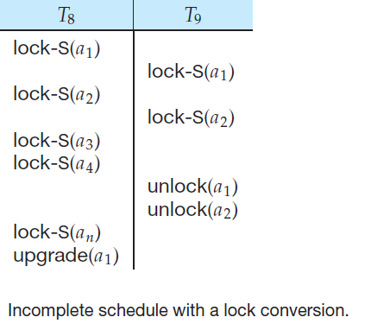
CONCURRENCY CONTROL
Sudha Bhagavatheeswaran, Department of Information Technology,
SIES College of Arts, Science & Commerce (Autonomous)

Slide 15
Deadlock Handling
CONCURRENCY CONTROL
A system is in a deadlock state if there exists a set of transactions such that every transaction in the set is waiting for another transaction in the set.
Remedy: rolling back some of the transactions
Two methods to deal with deadlock
  deadlock prevention
  deadlock detection and deadlock recovery
Sudha Bhagavatheeswaran, Department of Information Technology,
SIES College of Arts, Science & Commerce (Autonomous)

Slide 16
Deadlock Prevention
CONCURRENCY CONTROL
Two approaches
  Lock requests Ordering - To prevent cyclic waits
  Preemption and transaction rollback
First approach:- (disadvantages)
  Hard to predict which locks required and on which data items
  Data item utilisation may be low(they are locked but unused)
  Preemption and transaction rollback
  when a transaction Tj requests a lock that transaction Ti holds, the lock granted to Ti may be preempted by rolling back of Ti , and granting of the lock to Tj .
  timestamps are used to decide whether a transaction should wait or roll back. (timestamps are transaction start time)
Sudha Bhagavatheeswaran, Department of Information Technology,
SIES College of Arts, Science & Commerce (Autonomous)

Slide 17
Deadlock detection and recovery
CONCURRENCY CONTROL
An algorithm examines the state of the system is invoked periodically to determine whether a deadlock has occurred. (Detection)
If one has, then the system must attempt to recover from the deadlock. (Recovery)
To do so, the system must:
  Maintain information about the current allocation of data items to transactions, as well as any outstanding data item requests.
  Provide an algorithm that uses this information to determine whether the system has entered a deadlock state.
  Recover from the deadlock when the detection algorithm determines that a deadlock exists.
Sudha Bhagavatheeswaran, Department of Information Technology,
SIES College of Arts, Science & Commerce (Autonomous)

Slide 18
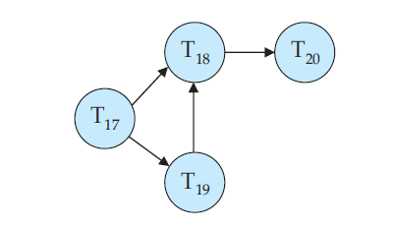
Deadlock detection
CONCURRENCY CONTROL
Deadlock can be represented as a wait-for graph.
When transaction Ti requests a data item currently being held by transaction Tj , then the edge Ti → Tj is inserted in the wait-for graph. This edge is removed only when transaction Tj is no longer holding a data item needed by transaction Ti .
A deadlock exisits only if the wait- for graph contains a cycle.
For eg:- T20 → T19 in the above diagram
Sudha Bhagavatheeswaran, Department of Information Technology,
SIES College of Arts, Science & Commerce (Autonomous)

Slide 19
Deadlock detection
CONCURRENCY CONTROL
When should we invoke the detection algorithm?
The answer depends on two factors:
  How often does a deadlock occur? Deadlock – frequent; algorithm - frequent
  How many transactions will be affected by the deadlock? Data items locked by a transaction are unavailable and number of transactions to be rollbacked.
Sudha Bhagavatheeswaran, Department of Information Technology,
SIES College of Arts, Science & Commerce (Autonomous)

Slide 20
Deadlock Recovery
CONCURRENCY CONTROL
1. Selection of a victim
  Determine which transaction (or transactions) to roll back
  Choose the transactions that will incur the minimum cost
  Factors that determine the cost
  How long the transaction has computed, and how much longer the transaction will compute before it completes
  How many data items the transaction has used and how many more data items the transaction needs for it to complete.
  How many transactions will be involved in the rollback.
2. Rollback :- Total or partial
3. Starvation:- Same transaction becomes the victim (Limit the count and include no. of rollbacks in the cost)
Sudha Bhagavatheeswaran, Department of Information Technology,
SIES College of Arts, Science & Commerce (Autonomous)

